Slide 1
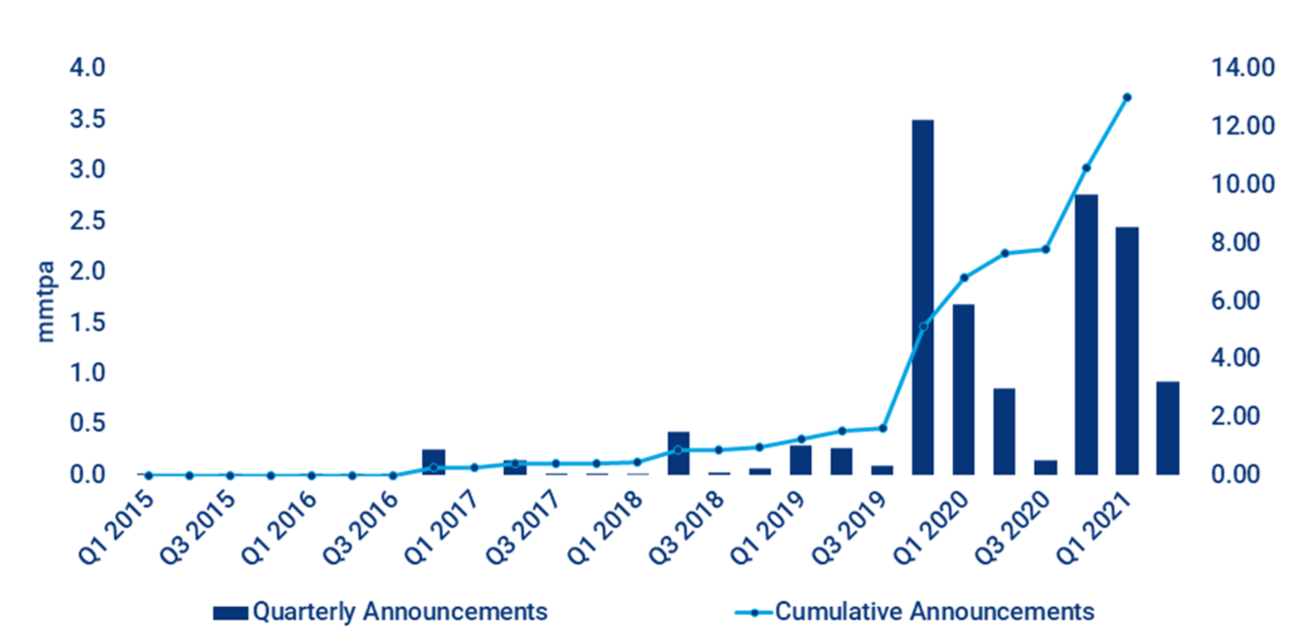
30 June 2021
Why Green Hydrogen Is Reaching a Tipping Point
An increasingly dynamic low-carbon hydrogen market has seen a deluge of government support, corporate commitments, announced projects and even bystander intrigue over the past 18 months. This activity amounts to a paradigm shift which will see green hydrogen – hydrogen created from the electrolysis of water using renewable energy – emerge as a key element of the energy transition, according to a report published recently by Wood Mackenzie energy research firm.
While cost remains a major obstacle to hydrogen technology, the report identified the following key factors that are contributing to the growth of green hydrogen.
Push Toward Decarbonisation – The last year has seen a decisive pivot towards decarbonisation globally which is extremely positive for zero-carbon technologies.
Rising Level of Investment – After a pandemic-related dip in Q2 and Q3 2020, investment in low-carbon hydrogen is once again on the up. At least US$4.5 billion was invested in the hydrogen market in Q1 2021 alone, with 55 projects announced. It is estimated that green hydrogen will be competitive with fossil fuels by 2028 to 2033, assuming a US$30/MWh power price in 2030.
Increase in Manufacturing Capacity of Electrolyser – The manufacturing capacity of electrolysers that was 200 MW in 2019, is now estimated to be 6.3 GW. About 1.3 GW was added in Q1 2021 alone.
Versatility of Hydrogen – A key advantage of hydrogen is that it acts as a versatile form of storable energy, making green hydrogen complimentary to renewable energy sources like wind and solar.
4.5
Billion US$ Invested
In the hydrogen market in Q1 2021, with 55 projects announced.
(Woodmac)
67%
of Pipeline Hydrogen
Is now estimated to come from electrolysis-based low-carbon production process.
(Woodmac)
17
Countries Including
Japan, South Korea and Canada have announced a hydrogen strategy, targets, and clear vision towards net-zero emissions.
(Woodmac)
Low-Carbon Hydrogen Project Announcements by Quarter
Q1 2017 – Q1 2021 (million metric tons per annum)
Source: Wood Mackenzie
Net Zero by 2050 Roadmap For the Global Energy Sector
A special report released by the IEA on May 18, 2021, shows that the pathway to the critical and formidable goal of net zero emissions is narrow, but will bring huge benefits. The report also shows that heat pumps and efficient cooling technologies have an important role in reaching the goal.
The pathway described in “Net Zero by 2050: a Roadmap for the Global Energy Sector” requires an unprecedented transformation of how energy is produced, transported and used globally. Climate pledges by governments to date – even if fully achieved – would fall well short of what is required to bring global carbon dioxide (CO₂) emissions to net zero by 2050. The report further underscored that achieving net zero by 2050 will give the world an even chance of limiting the global temperature rise to 1.5 °C, in line with the goals of the Paris Agreement.
The report is the world’s first comprehensive study of how to transition to a net zero energy system by 2050 while ensuring stable and affordable energy supplies, providing universal energy access, and enabling robust economic growth. It sets out a cost-effective and economically productive pathway, resulting in a clean, dynamic and resilient energy economy dominated by renewables instead of fossil fuels. The report also examines key uncertainties, such as the roles of bioenergy, carbon capture and behavioural changes, in reaching net zero.
The roadmap sets out over 400 milestones to guide the global journey to net zero by 2050. These include, from today, no investment in new fossil fuel supply projects, and no further final investment decisions for new coal plants.
500
Trillion USD Total
The net zero pathway is expected to result in annual energy investment surge to US$500 Trillion by 2030, adding an extra 0.4% a year to global GDP growth.
(IMF)
≈ 90%
of Electricity Generation
by 2050 is expected to come from renewable sources, with wind and solar PV together accounting for almost 70%.
(IEA)
≈ 40
Billion USD Per Year
The cost of providing electricity to around 785 million people and clean cooking solutions to 2.6 billion people.
(IEA)

